Slide 1
Geothermal Energy Status in Türkiye and Compared with The World
Ahmet Fırat Küçük – 150719679
Nurullah Said Tüğmen – 150720823

Slide 2
What is Geothermal Energy?
Geothermal energy is an important part of renewable for Turkey. It is usually used as a geothermal heating and produces %3 for Turkey’s electricty[3].
This energy is stored in rocks and fluids in the centre[6].
The rock and water in the Earth’s crust can reach heats of around 370 Celcious[6].
This energy, which exists in rocks and liquids, can also be found at shallow depths, a few miles below the Earth’s surface.
Geothermal energy can also be used in something. For example, it can be used for cooking and heating.
It can be used for electricty generation and other heating and cooling applications.
Geothermal energy can also be used in some areas. For example, it can be used for cooking and heating. It can be used for electricity generation and other heating and cooling applications[6].

Slide 3
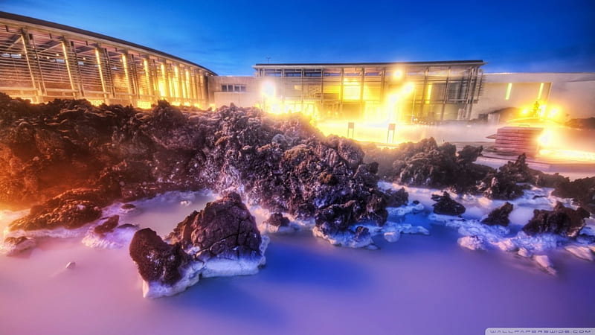

Slide 4
How Does It Work?
In order to benefit from geothermal resources, wells are drilled to a certain depth in underground reservoirs.
These resources can be exploited through advanced geothermal systems that increase or create resources due to heat and water permeability.
One of the tasks of these geothermal sources is to run turbines connected to electric generators.
Geothermal power plants come in three different designs; dry steam, flash and binary.
The oldest type is dry steam, which takes steam directly from fractures in the ground to drive a turbine. Flash plants pull high pressure hot water from underground and mix it with cooler low pressure water.
This, in turn, creates steam that is used to drive a turbine. Binary plants use hot water passed through a secondary fluid that has a lower boiling point than water.
The secondary fluid is turned into vapour which drives a turbine. Most future geothermal power plants are expected to be binary plants.

Slide 5
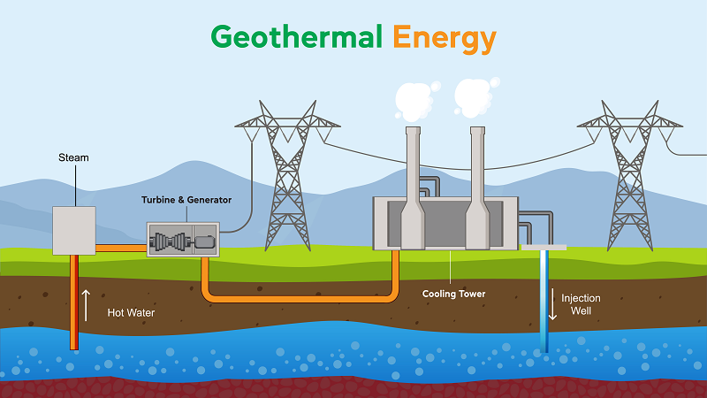

Slide 6
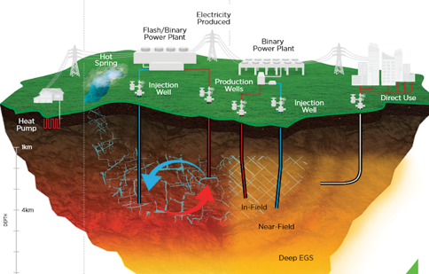
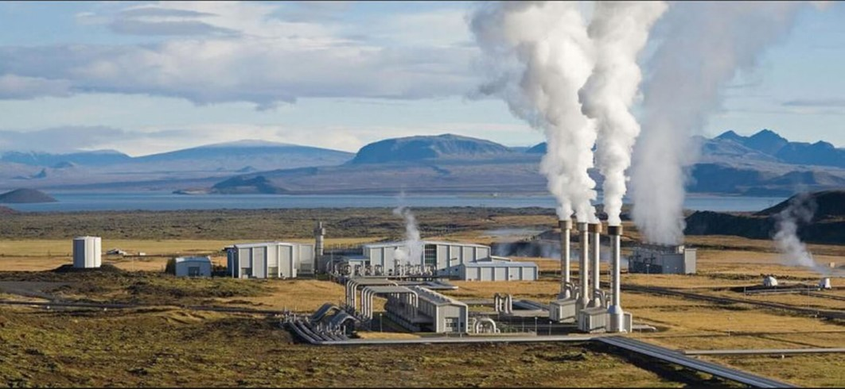
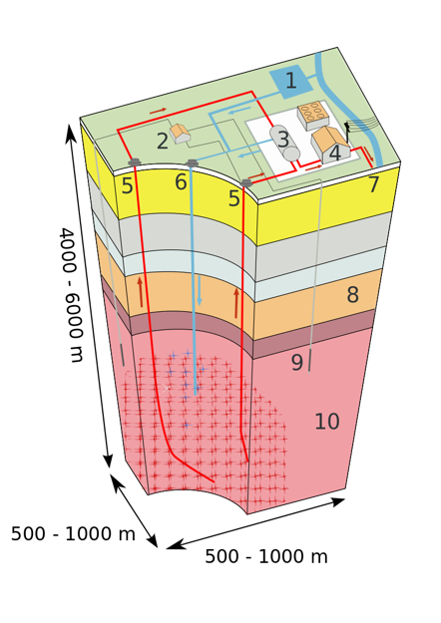
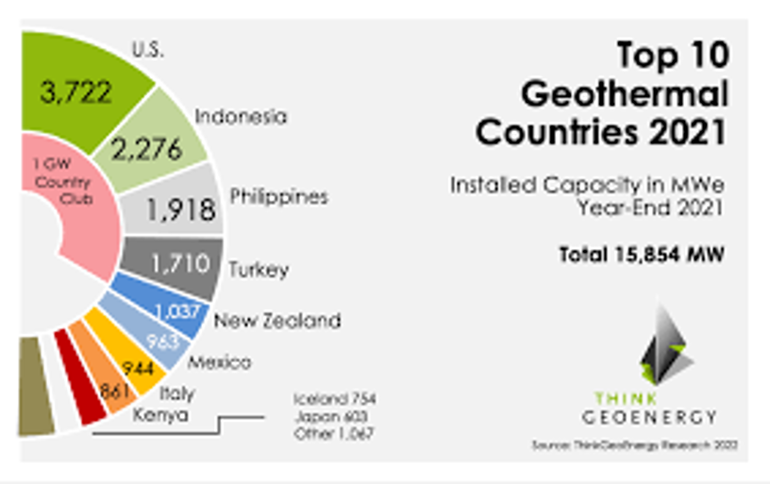
Concept & Application

Slide 7
Geothermal Energy in Turkey
Geothermal energy is important part of renewable energy for Turkey. It produces 3% of Turkey’s electricity[3]. Turkey is the world’s second largest user of geothermal energy. In Turkey, Mineral Research and Exploration Directorate started its first geological and geophysical surveys in the southwest in 1965[4]. As a result of these investigations, it was determined that the Kızıldere geothermal reservoir was suitable for electricity generation, and a small 500 kW power plant was built thereupon in 1974. And free electricity was distributed to nearby houses.

Slide 8
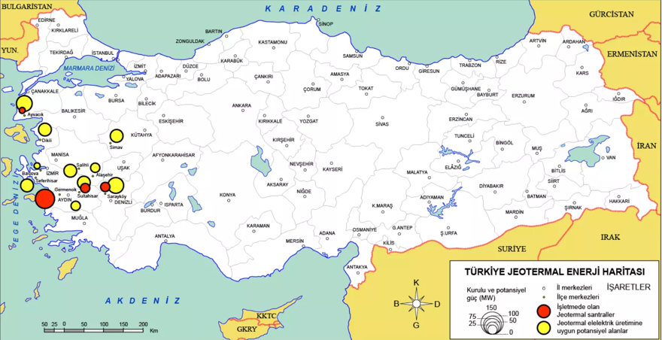
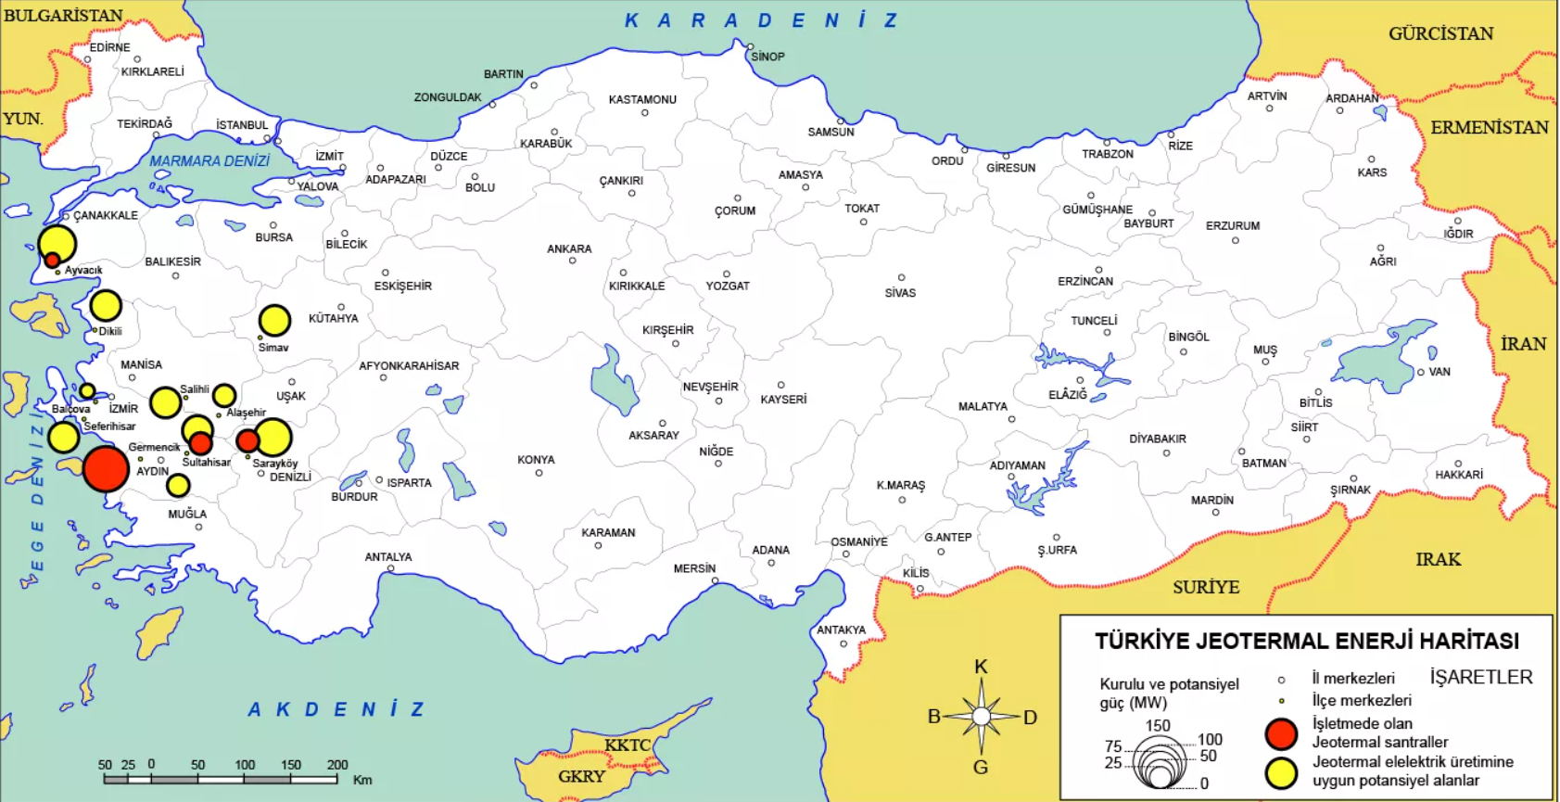

Slide 9
Geothermal Energy in Turkey
This power plant was privatized to Zorlu energy in 2008 and since 2022, Kızıldere Geothermal Power Plant is Turkey's largest power plant[5]. In Turkey, there were concerns about the release of heavy metals to water and soil in the 2010s, and also in 2017, no heavy metal pollution from power plants was found, although boron was found in 2017, which could harm crops. Arsenic has been found in gray water from heating, and it has been suggested that such water could be filtered with biochar.

Slide 10
Geothermal Energy in Turkey
Financially, geothermal energy has high costs and therefore financial risks, but if public money is invested early in a project, it can help investors complete financing.In 2022, the World Bank, along with Turkey Sinai Bank, a partially state owned industrial development bank, provided 300 million loans to private companies for geothermal energy.

Slide 11
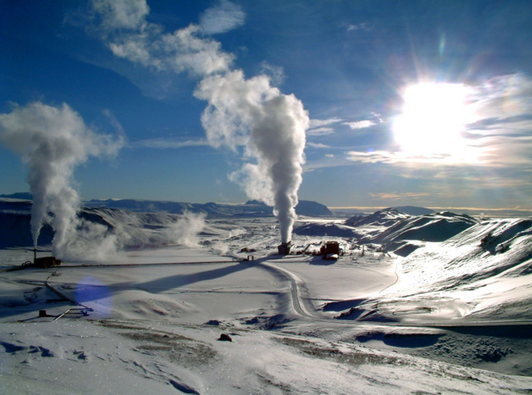

Slide 12
Geothermal Energy Status in Turkey and Compared with The World
Among all renewable energy sources, geothermal energy is a suitable option for heating and power production. It is both a sustainable source and independent of meteorological conditions. Geothermal power production has higher capacity factors (> 80%) compared with other renewable energy resources and it has an advantage in the capability of supplying base load electricity for the investors (IRENA, 2017).
Among countries with geothermal energy production, Turkey is located in the top four, with 41 numbers geothermal power plants around the world in 2018. Total installed geothermal power capacity of the country is approximately 1.4 GWe for 2018 and the new target set by the Turkish Ministry of Energy and Natural Resources is 4000 MWe by 2030. Since the 1960s, more than 200 geothermal fields have been identified in Turkey by the General Directorate of Mineral Research Application (MTA), and geothermal exploration continues

Slide 13
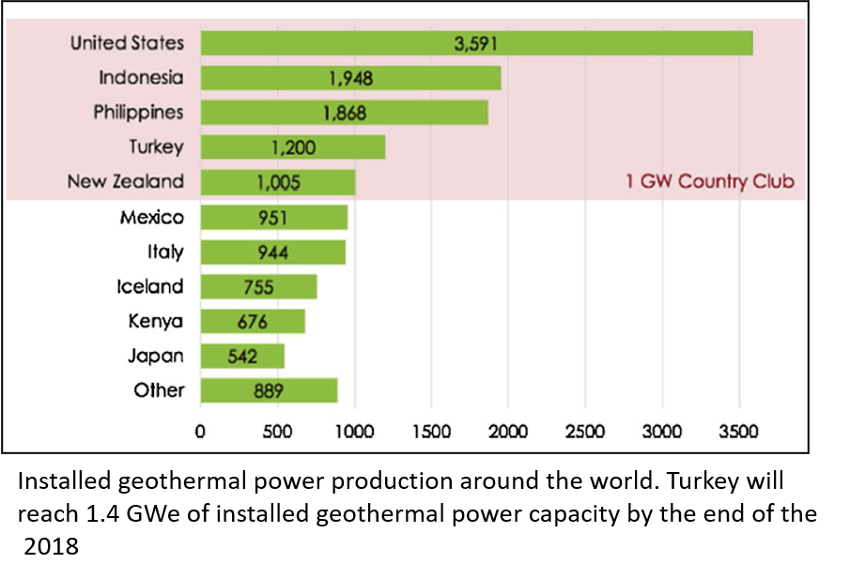

Slide 14
Geothermal Energy Status in Turkey and Compared with The World
Nearly all identified geothermal systems have water-dominated reservoirs and temperatures are quite different from the West to the East. Western Anatolia has large graben systems and the highest reservoir temperatures (up to 245 ⁰C), while the middle and the eastern regions have lower reservoir temperatures. Based on the reservoir temperatures in these parts, Western Anatolia has been deemed more suitable for geothermal power production while the other regions have used this resource primarily for district heating and low temperature applications. For 2018, Turkey’s installed geothermal power capacity is approximately 1100 Mwe and the installed heating capacity is around 3300 Mwt (TJD, 2018). Turkey is located on the Alpine-Himalayan orogenic belt and it is affected by different tectonic zones such as the North Anatolian Fault, the Eastern Anatolian Fault, and the Aegean Extension Zone. Some volcanics have been identified in the Western region of the country (Kula volcanics) as well as the Eastern region (Nemrut volcanics). These geological activities provide access to geothermal sources across Turkey with a considerable range of temperatures .

Slide 15
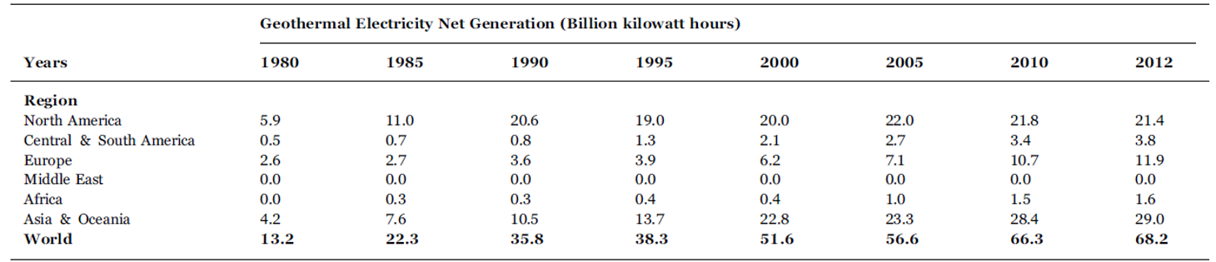

Slide 16
Conclusion
Turkey has an important geothermal power source as well as different geothermal power technologies producing energy in Western Anatolia. These geothermal power plants have high capacity factors and they can only be sustainable and cost effective if reservoirs and power plants operate efficiently during long license durations.
There are a few critical chemistry challenges to be considered during design and operating phases of geothermal power plants. Depending on reservoir temperatures, fluid chemistry, and non-condensable gas composition and concentrations and fluid production rates, geothermal power plant operations require different maintenance applications such as prevention of scaling, corrosion, reservoir cooling problems because of water interactions, sea intrusion effects and the decline of reservoir pressure in geothermal reservoirs in Western Anatolia.

Slide 17
References
[1] Aoife Foley, M. Ouladsine, Renewable and Sustainable Energy Reviews Volume 6, Issues 1-2, 2002, Pages 3-65
[2] Mary H. Dickson, Mario Fanelli, “Geothermal Energy Utilization and Technology”, 2003.
[3]https://en.wikipedia.org/wiki/Geothermal_energy_in_Turkey#:~:text=People%20have%20been%20bathing%20in,fourth%20largest%20in%20the%20world
[4]https://www.thinkgeoenergy.com/power-energy-electricity-heat-and-geothermal-the-importance-of-the-right-terminology/
[5]https://www.twi-global.com/technical-knowledge/faqs/geothermal-energy

